Slide 1
Wholesale Restaurant Supply Store
Sales Analytics

Slide 2
Wholesale Restaurant Supply Store
Sales Performance Metrics | Purchase Analytics | Market Basket Analysis | Time Series Modeling

Slide 3
Outline
Business Background
Sales Performance Metrics
Produce Department
Purchase Analytics
Market Basket Analysis
Time Series Modeling

Slide 4
Business Background
Business Context | Business Problem | Data Description

Slide 5
Business Context
Online Wholesale Restaurant Supply Store which provides beverages, paper products, catering supplies etc to restaurants and caterers.
Its customer base is from across the US.
Sales and Marketing Executives (non-tech decision-makers) interested in seeing the product that scaled and the product that didn't scale,
and understanding how this varies by branch. Also interested in knowing the branch that made the most and least profit (their expectations)
This visual will answer for when executives are trying to know what branch(es) to double down efforts or what products to do
more advertising for, so sales would soar. They want recommendation on whether to hire more employees, categories moving faster or slower etc.

Slide 6
Assumptions Made

Slide 7
Data Description
Raw data sourced from Kaggle: https://www.kaggle.com/codemysteries/salesdb
Modified and cleaned the data to make it more intuitive and relatable.

Slide 8
Business Toplines
- Data Extraction Date
- Timeframe
- Users (Customers) = X+ (discount, loyal, need-based customers)
- Distinct Items = 452
- Distint Categories = 20
- Revenue
Notes:
- Decide on metric for quantifying business problem
- Give topline numbers
- Slice topline numbers according to region, customer type, sales day of week, sales week of month, sales time of day

Slide 9
Other Metrics
Notes:
Business Topline Metrics
Customers
Total number of customers/ users
First-time vs Repeat customers
Customer growth trend
Demographic of customers
Employees
Total number of employees
Employee growth trend
Demographic of employees
Gender distribution of employees
Biological age distribution
Service age distribution
Products
Number of categories
Average category unit price
Sales
Total revenue (volume)
Total revenue growth trend month-on-month (volume)
Average revenue month-on-month
Total unit of items bought per category
Day of week, Time of day, Week of month with most frequent:
Sales/Revenue (volume and value)
Discounts (volume and value)
Customer Usage Metrics
Average order size month-on-month
Most popular category patronized per month
Average order spend month-on-month
Total spend month-on-month overlaid with average order size all time
Average discount received month-on-month
Employee Performance Metrics
Total sales per employee
Average sales per employee per month
Employee with most customer spend each month

Slide 10
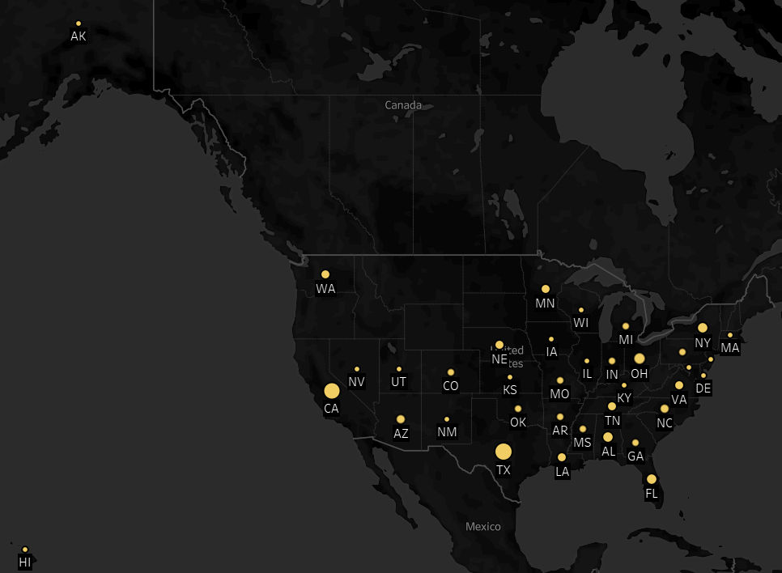
Customer Distribution
Notes:
Insight from all the visuals

Slide 11
Sales Performance Metrics
Produce Department
Notes:
Whats out North Star Metric

Slide 12
Key insights, using icons
Part of the business metrics
💰 Revenues tripled, rising from £58.2 million to £162.7 million
📈 Retail customer growth increased by 186%, climbing from 3.5 million to 10 million (now 13 million)
💼 Business customer growth increased by 260%, climbing to 220,000 (now 500,000)
📱 Daily active customers increased by 231%, while the number of paying customers increased by 139%
💳 Customer deposits increased from £890 million to £2.3 billion
📊 Operating losses increased to £107.4 million due to global hiring and expansion. However, despite Covid-19, we are still on track to break-even in the near future

Slide 13
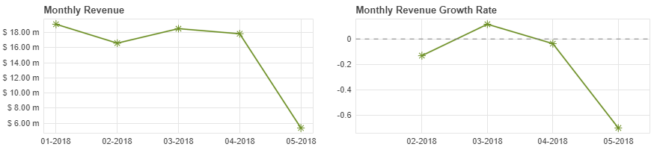
Revenue Trends

Slide 14
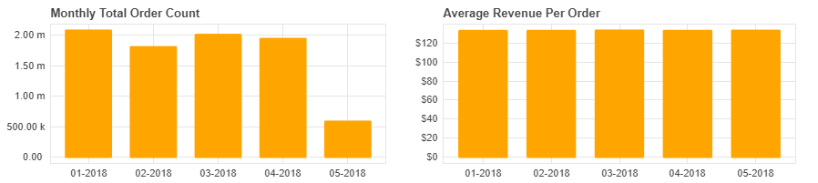
Order Trends

Slide 15
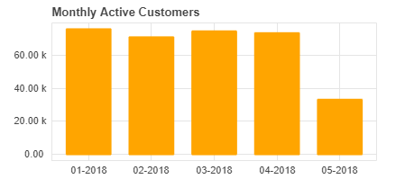
Customer Trends

Slide 16
Customer Trends

Slide 17
Title and Content Layout with Chart

Slide 18
Two Content Layout with Table
First bullet point here
Second bullet point here
Third bullet point here
Class | Group A | Group B
Class 1 | 82 | 95
Class 2 | 76 | 88
Class 3 | 84 | 90

Slide 19
Two Content Layout with SmartArt
First bullet point here
Second bullet point here
Third bullet point here
Group A
Task 1
Task 2
Task 3

Slide 20
Add a Slide Title - 1

Slide 21
Add a Slide Title - 3

Slide 23
Add a Slide Title - 4

Slide 24
Add a Slide Title - 5

Slide 25
Big Take-Away
Recommendations
Notes:
What is the big takeaway - stakeholder should act or not act and implication of acting and also of not acting

Slide 26
Statistical Projections
Recommendations
Notes:
Make statistical projection of growth in X number of years. Header should describe action that is recommended. Statistical projection,
visualized on chart will make the story more compeling

